Slide 1
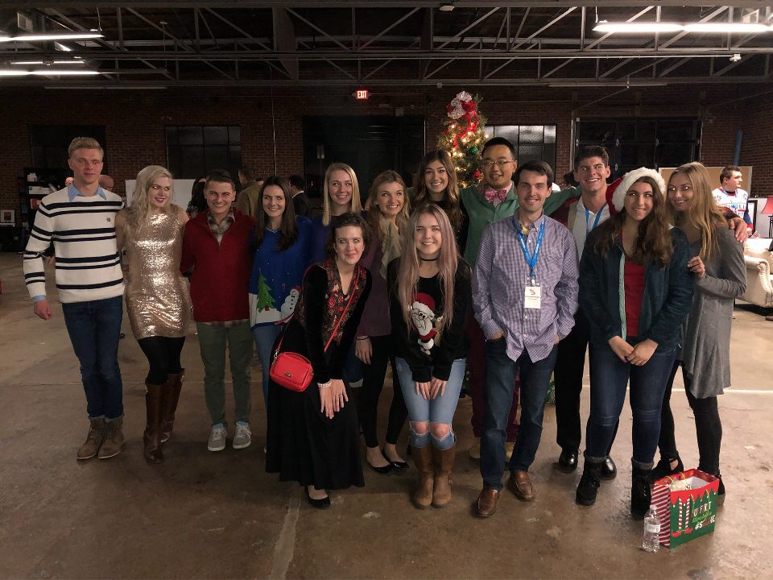
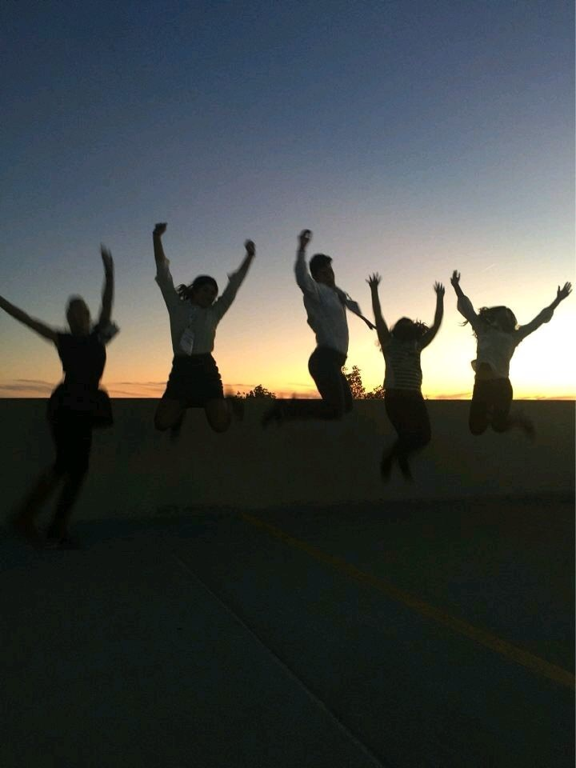
Internet Summit 2018
TMC25
TMC25
Why not buy something you are already going to buy and save 25 dollars off the lowest price Internet Summit offers for the FULL conference, all while helping an intern attend the event!
Internet Summit Ticket options:
https://internetsummit.com/tickets/
Interest? Buy tickets here:
https://www.eventbrite.com/e/internet-summit-2018-digital-marketing-conference-tickets-39496096889

